Slide 1

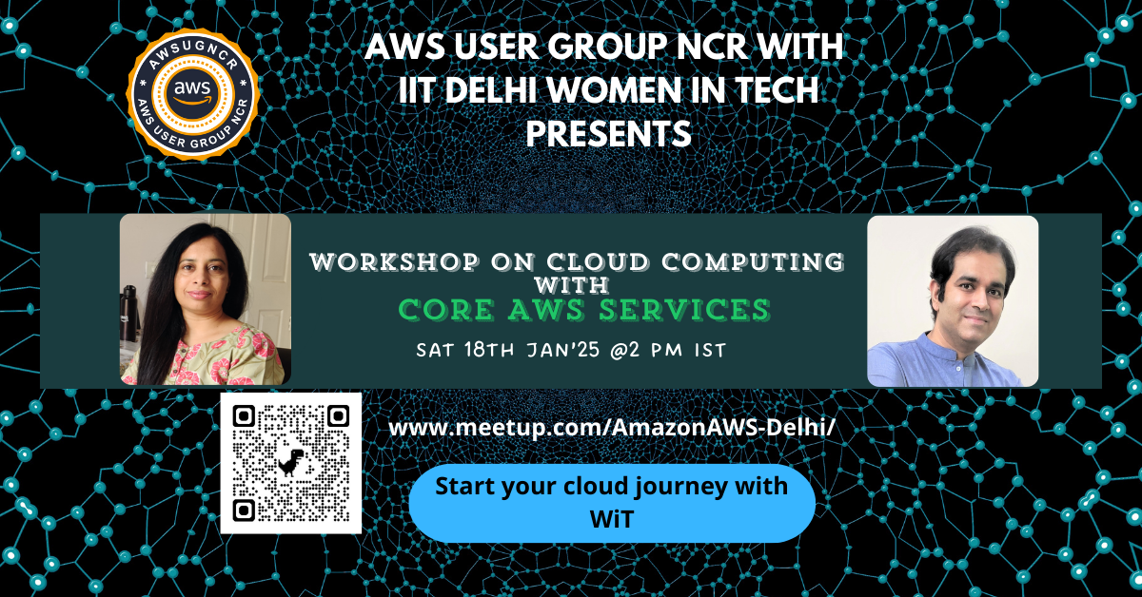

Slide 2

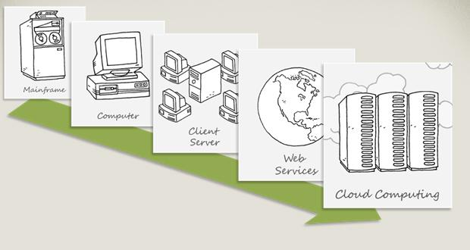
Technology Trends
Technology Trends

Slide 3
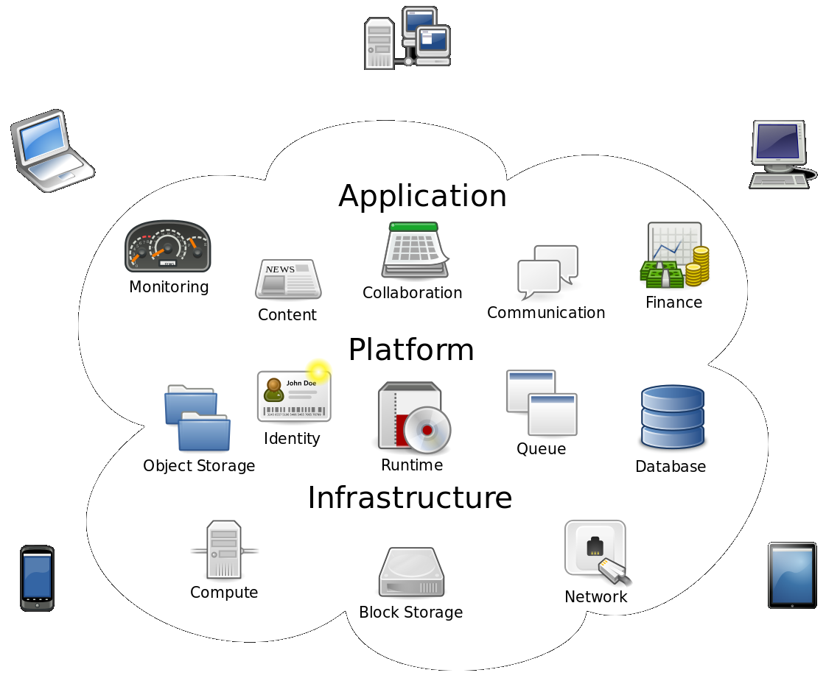
Cloud computing
Cloud computing is a term broadly used to define the on-demand delivery of IT resources like servers, storage, databases, networking, software, and applications over the internet (“the cloud”) with pay-as-you-go pricing.
Cloud computing provides a simple way to access servers, storage, databases and a broad set of application services over the Internet.

Slide 4
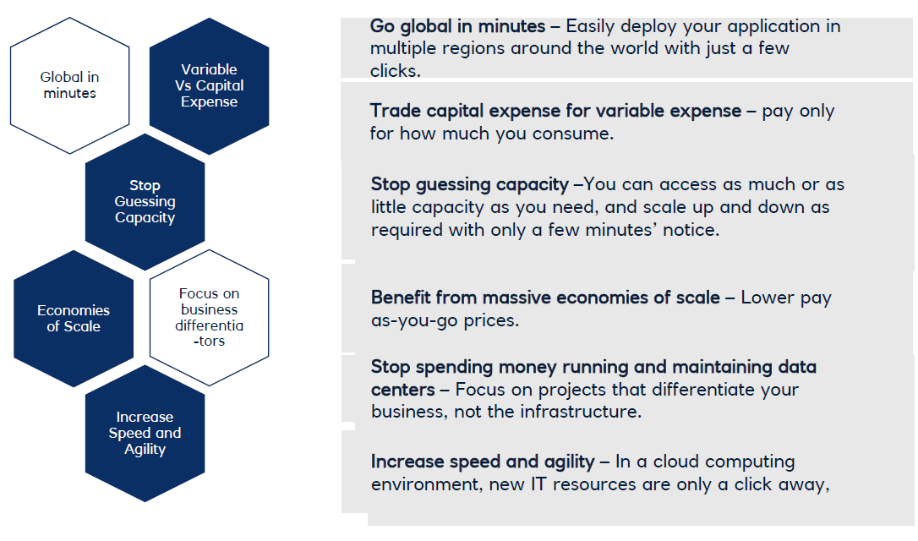
Advantages of Cloud

Slide 5
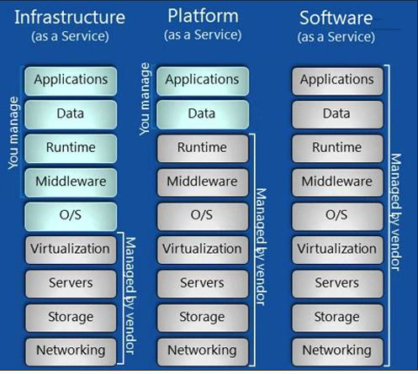
Types of Cloud Computing
Cloud services are broadly categorized as
Infrastructure as a service (IaaS)
Platform as a Service (PaaS)
Software as a Service (SaaS)

Slide 6
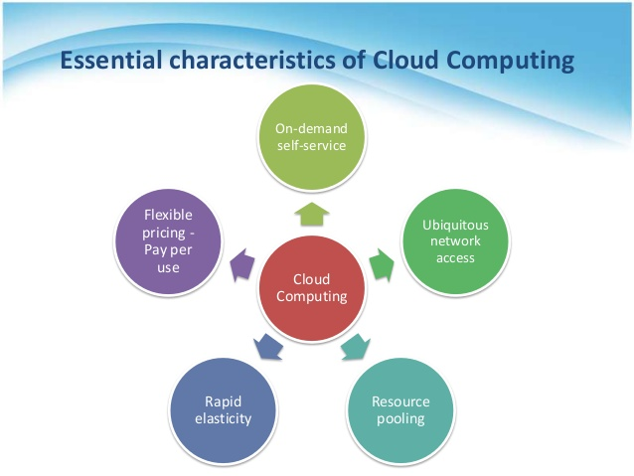
Characteristics of Cloud
Key Cloud Characteristics –
On-Demand Self Service
Broad Network Access
Resource Pooling
Rapid Elasticity
Measured Service

Slide 7
Cloud Deployment Models
According to where the infrastructure for the deployment resides and who has control over that infrastructure, NIST defines four cloud deployment models:
Public clouds
Private clouds
Hybrid clouds
Community clouds
Public Cloud
Public clouds are environments that are entirely managed and serviced by an external service provider.
When most people think about computer clouds, it is public clouds they are thinking about.
The cloud infrastructure is provisioned for open use by the general public. It may be owned, managed, and operated by a business, academic, or government organization, or some combination of them.
Private Cloud [on-prem]
A private cloud consists of computing resources used exclusively by one business or organisation.
The private cloud is physically located at your organisation’s on-site data centre
It may be managed either by the consumer organization or by a third party.

Slide 8
Hybrid Cloud
Often called “the best of both worlds”, hybrid clouds combine on-premises infrastructure, or private clouds, with public clouds so that organisations can reap the advantages of both.
In a hybrid cloud, data and applications can move between private and public clouds for greater flexibility and more deployment options.
In a hybrid cloud, “cloud bursting” is also an option. This is when an application or resource runs in the private cloud until there is a spike in demand (such as a seasonal event like online shopping or tax filing), at which point the organisation can “burst through” to the public cloud to tap into additional computing resources.
Community Cloud
Community clouds aren't used as much as public or private clouds; in fact, they are the least known and least used cloud deployment model. In a community cloud, the cloud is shared by a group of organizations that have a common purpose or goal. The cloud environment is generally built to help them achieve that purpose or goal.

Slide 9
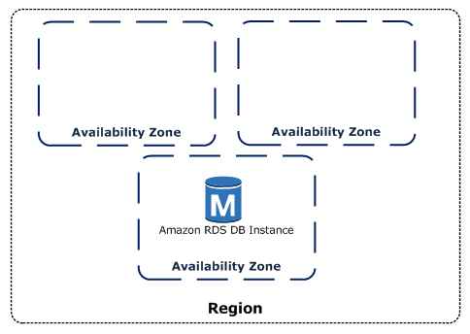
AWS Global Infrastructure
AWS are constantly expanding around the world and currently there are:
• 24 regions
• 76 availability zones
Interactive and up-to-date infrastructure information is available at: infrastructure.aws
AWS Regions
A region is a geographical area, Each region consists of 2 or more availability zones
Each Amazon Region is designed to be completely isolated from the other Amazon Regions
Note that there is a charge for data transfer between regions
Availability Zones (AZs)
Availability Zones are physically separate and isolated
from each other
AZs span one or more data centres and have direct,
low-latency, high throughput and redundant network
connections between each other
An Availability Zone is represented by a region code
followed by a letter identifier; for example, us-east-1a

Slide 10
AWS EC2 (Elastic Compute Cloud)
Compute is one of the key foundational building blocks of the cloud computing infrastructure layer. "compute" refers to physical servers comprised of the processing, memory, and storage required to run an operating system such as Microsoft Windows or Linux, and some virtualized networking capability.
Amazon EC2 is a web service that provides resizable compute capacity in the cloud.
Amazon EC2 reduces the time required to obtain and boot new server instances to minutes, allowing you to quickly scale capacity, both up and down as computing requirement changes.
You have root access to each of your EC2 instances
You can Stop, Start, Reboot or Terminate your EC2 instances
You can provision your EC2 instances on Shared or dedicated hosts
You need a AMI to launch any EC2 instance.
EC2 instance metadata (from EC2 instances console)
GET (or curl) http://169.254.169.254/latest/meta-data
An Amazon Machine Image (AMI) is a special type of virtual appliance that is used to create a virtual machine within EC2. AMIs come in three main categories:
• Community AMIs – free to use, generally you just select the operating system you want
• AWS Marketplace AMIs – pay to use, generally come packaged with additional, licensed software
• My AMIs – AMIs that you create yourself

Slide 11
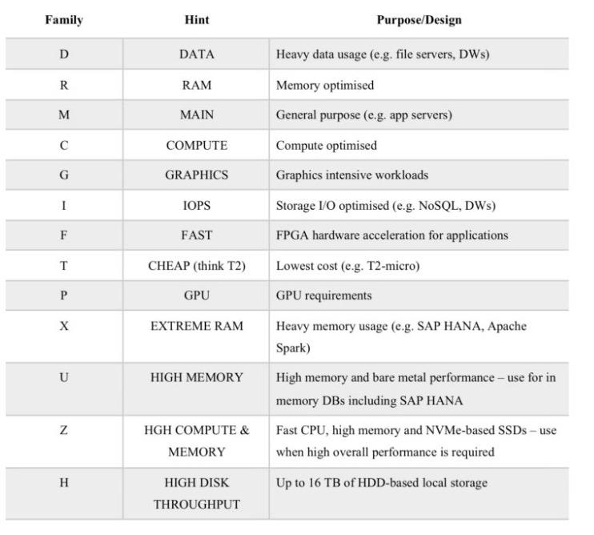
EC2 Families
General purpose
- Balanced memory and CPU
- suitable for most applications
Ex. M3, M4, T2
Compute Optimized
- More CPU than memory
- Compute intensive use
Ex C2, C4
Memory optimized
- More RAM/Memory
- Memory intensive apps, DB, caching
Ex R3, R4
GPU Compute instances
- Graphics Optimized-
- High performance and parallel computing, Ex G2
Storage Optimized
- Very High, Low latency,
- I/O optimized I/O intensive apps, data warehousing, hadoop
Ex I2, D2

Slide 12
EC2 Instance Pricing
On-demand:
• Low cost and flexibility of EC2 without any up-front payment or long term commitment
• Applications with short term, spiky, or unpredictable workloads that cannot be interrupted
Reserved:
• Applications with steady state or predictable usage
• Users can make up-front payments to reduce their total computing costs even further
• Standard Reserved Instances (RIs) provide up to 75% off on-demand price
Spot:
• Applications that can be interrupted or only feasible at very low compute prices
• Users with an urgent need for a large amount of additional compute capacity
• If Amazon terminate your instances you do not pay, if you terminate you pay for the hour
Dedicated hosts:
• Useful for regulatory requirements that may not support multi-tenant virtualization
• Can be purchased on-demand (hourly) or Reserved for up to 70% off the on-demand price
LAB – Create your own EC2 Instance

Slide 13
AWS EBS – Elastic Block Store
Amazon Elastic Block Store (Amazon EBS) provides persistent block storage volumes for use with Amazon EC2 instances in the AWS Cloud
Each Amazon EBS volume is automatically replicated within its Availability Zone to protect you from component failure, offering high availability and durability
EBS volume data persists independently of the life of the instance, Root EBS volumes are deleted on termination by default
EBS volumes can be backed up by creating a snapshot of the volume, which is stored in Amazon S3. EBS volumes can be created from a snapshot can be attached to an another instance within the same region
EBS volumes are created in a specific Availability Zone, and can then be attached to any instances in that same Availability Zone. To make a volume available outside of the Availability Zone, create a snapshot and restore that snapshot to a new volume anywhere in that region.

Slide 14
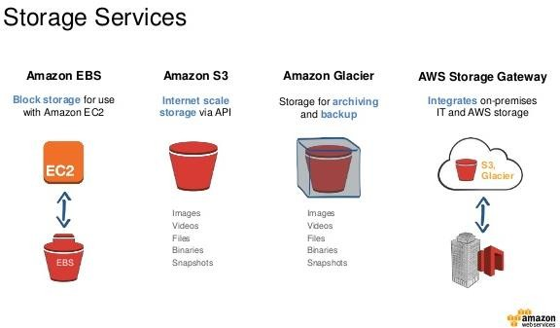
AWS Storage Services
Amazon Simple Storage Service (Amazon S3) – Object based storage
Amazon Glacier – Archival Solution
Amazon Elastic Block Store (Amazon EBS) – block based storage with EC2
Amazon Elastic File System (Amazon EFS) – File storage with EC2
AWS Storage Gateway - hybrid storage between on-premises storage environments and the AWS Cloud
AWS Snowball - Petabyte-scale data transport solution

Slide 15
AWS S3 - Simple Storage Service
Amazon S3 is object storage built to store and retrieve any amount of data from anywhere – web sites and mobile apps, corporate applications, and data from IoT sensors or devices
You can store any type of file in S3
S3 is designed to deliver 99.999999999% durability, and 99.99% availability and stores data for millions of applications used by market leaders in every industry
S3 objects are automatically stored across multiple devices spanning a minimum of three Availability Zones, each separated by miles across an AWS Region.
Buckets are fundamental container in S3
Objects are the entities stored in buckets in Amazon S3. Objects consist of object data
and metadata.
Objects (Files) can be anywhere from 0 bytes to 5 TB
S3 is a universal namespace so bucket names must be unique globally
When you successfully upload a file to S3 you receive a HTTP 200 code
Once data is stored in Amazon S3, it can be automatically tiered into lower cost, longer-term cloud storage classes like Amazon S3 Standard - Infrequent Access and Amazon Glacier for archiving.
Amazon S3 guarantees high-availability by replicating data across many servers and Azs
Read After Write Consistency for Puts of new objects
Eventual consistency for overwrite PUTS and DELETES

Slide 16
AWS S3 - Glacier
Extremely Low-cost, secure, durable storage service for data archiving and long-term backup.
Designed to deliver 11 9’s durability
To archive objects, define archival rules identifying objects and a timeline when you want Amazon S3 to archive these objects to Amazon Glacier.
Set the rules on a bucket using the Amazon S3 console or programmatically using the Amazon S3 API or AWS SDKs.
Retrievals as quick as 1-5 min [Expedited 1-5 min, Standard 3-5 hours, Bulk 5-12 hours]
Unmatched durability and scalability
Most comprehensive Security and Compliance capabilities
Extremely Low cost
Benefits of Glacier

Slide 17
AWS S3 – Lets see it in Action
Create S3 Bucket
Upload files
Host a static webpage
Host static website on your DNS via Route53
Change bucket permissions
Use S3 via CLI

Slide 18
THANKS

